Slide 1
Computer Simulation
Module 2: Calculus, Probability, and Statistics Primers
Dave Goldsman, Ph.D.
Professor
Stewart School of Industrial and Systems Engineering
Calculus Primer

Slide 2
Lesson Overview
Last Module: We gave a high-level overview on what simulation is.
This Time: This module will present various boot camps. Let’s start with a Calculus lesson.
Dirty Little Secret: There’s nothing new here if you’ve taken the prerequisites.

Slide 3

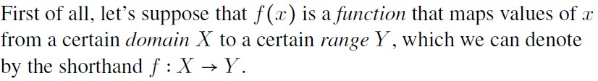

Calculus Primer

Slide 4
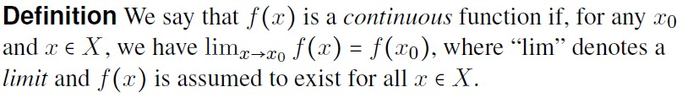
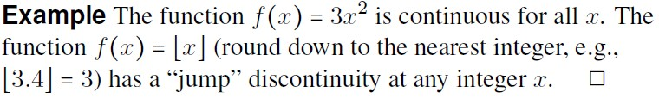
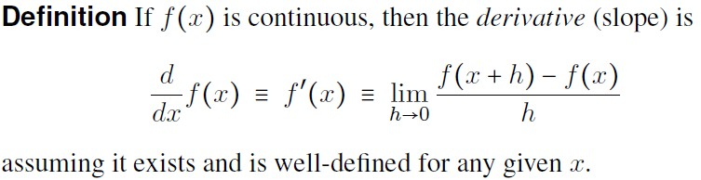

Slide 5






Some Old Friends

Slide 6





Slide 7




Slide 8
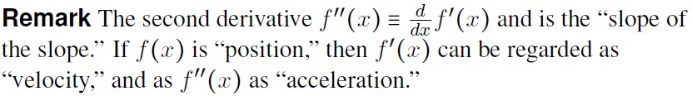
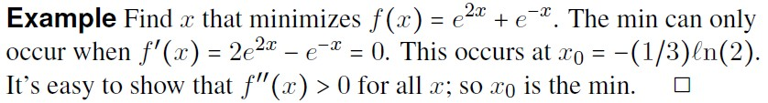

Slide 9
Summary
This Time: Some Calculus derivative memories. What’s not to love?
Next Time: Saved by Zero! We’ll give some numerical techniques to solve nonlinear equations.

Slide 10
Computer Simulation
Module 2: Calculus, Probability, and Statistics Primers
Dave Goldsman, Ph.D.
Professor
Stewart School of Industrial and Systems Engineering
Saved By Zero! Solving Equations

Slide 11
Lesson Overview
Last Time: Talked about Calculus basics. At the end, we searched for the solution to a nonlinear equation (finding a zero).
This Time: Some formal ways to conduct the search.
This material will be used several times in the course… take my word for it!

Slide 12
Finding Zeroes
How might you find a 0 for a complicated nonlinear function, i.e., x such that f(x) = 0?
Trial-and-error (not so great).
Bisection (divide-and-conquer).
Newton’s method (or some variation)
Fixed-point method (we’ll do this later).

Slide 13


Slide 14
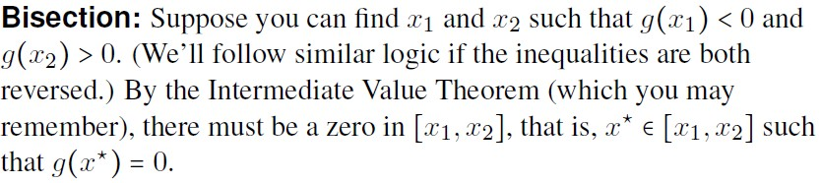
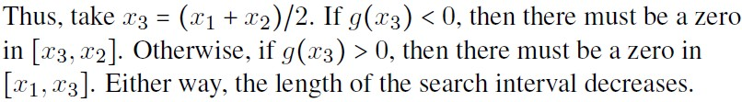

Slide 15
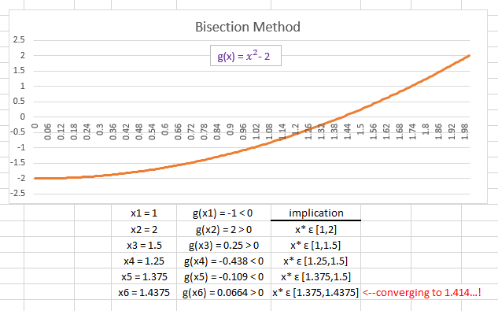

Slide 16
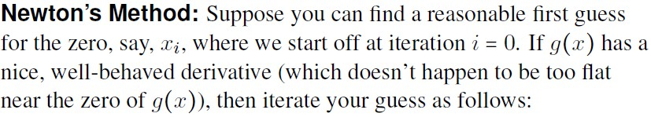
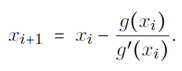
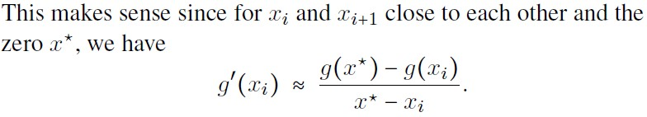

Slide 17
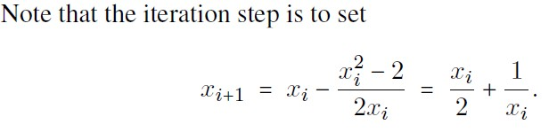
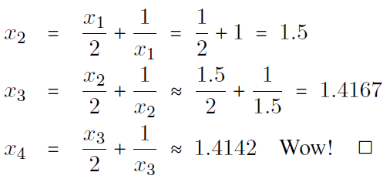

Slide 18
Summary
We went over some basic techniques to solve nonlinear equations for zeroes.
Next Time: The battle of Leibniz vs. Newton — it’s integration time!

Slide 19
Computer Simulation
Module 2: Calculus, Probability, and Statistics Primers
Dave Goldsman, Ph.D.
Professor
Stewart School of Industrial and Systems Engineering
Integration

Slide 20
Lesson Overview
Last Time: How do you find a zero of a complicated function?
This Time: What goes up must come down! A couple of lessons ago, we reviewed derivatives.
Now integration.
Hopefully, you’ll remember many old friends.

Slide 21
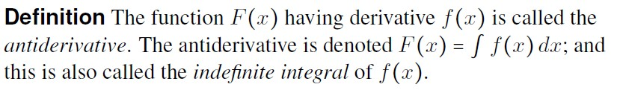
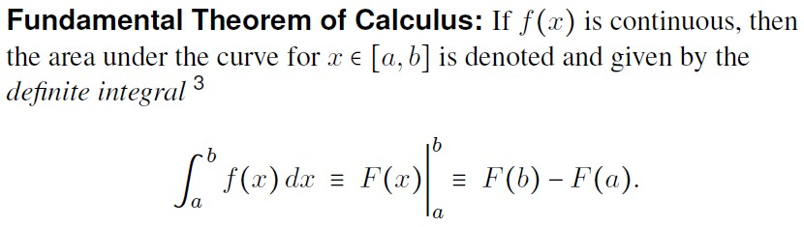

Integration

Slide 22





Friends of Mine

Slide 23







Slide 24



Slide 25



Slide 26

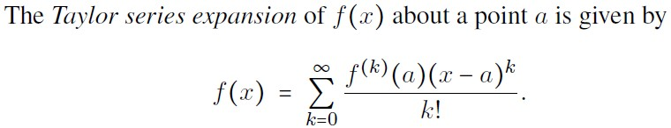

Slide 27
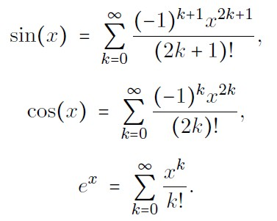
Maclaurin Friends

Slide 28
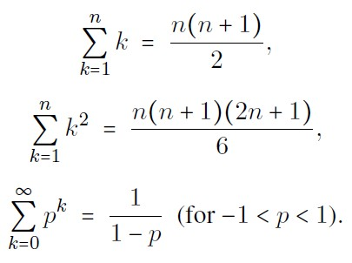
While We’re at it…

Slide 29
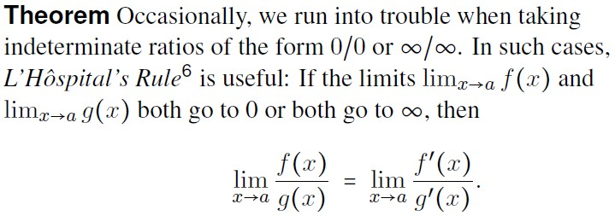

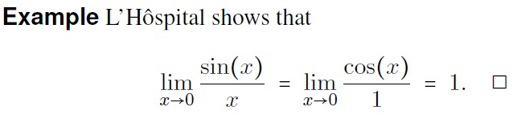

Slide 30
Summary
We renewed acquaintances with some old integral friends.
Next Time: We’ll look at some numerical integration techniques if those friends don’t want to come out and play.

Slide 31
Computer Simulation
Module 2: Calculus, Probability, and Statistics Primers
Dave Goldsman, Ph.D.
Professor
Stewart School of Industrial and Systems Engineering
Integration Computer Exercises

Slide 32
Lesson Overview
Last Time: A puntastic integration review.
This Time: Implement several numerical techniques that you might need to use if you can’t find a nice, pretty closed-form solution to your integral.
One of these techniques incorporates simulation!

Slide 33
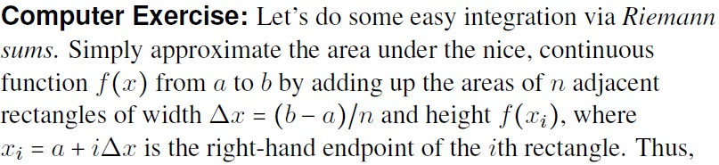



Slide 34
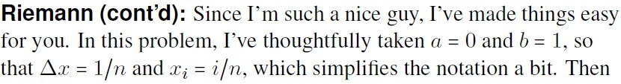
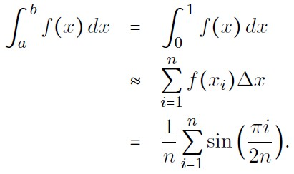

Slide 35
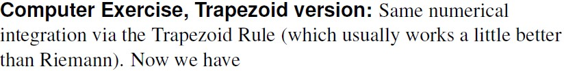
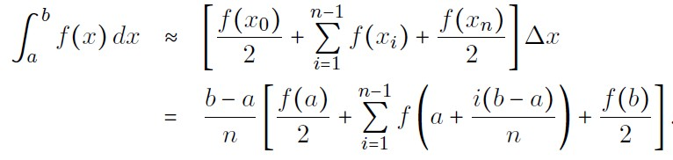


Slide 36
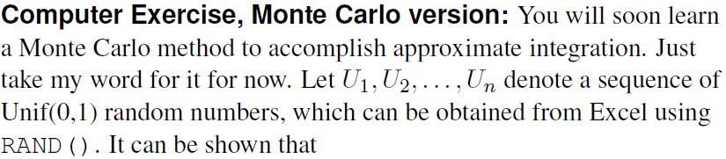
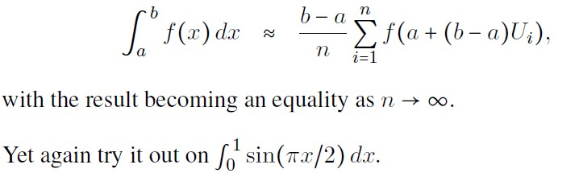

Slide 37
Summary
Went over some easy numerical integration techniques. We snuck in a little simulation while we weren’t looking.
Next Time: It is highly likely that we’ll be starting our Probability Primer.

Slide 38
Computer Simulation
Module 2: Calculus, Probability, and Statistics Primers
Dave Goldsman, Ph.D.
Professor
Stewart School of Industrial and Systems Engineering
Probability Basics

Slide 39
Lesson Overview
Last Time: We completed our Calculus Primer!
This Time: We’ll start our review of Probability with some basics.
If you are a probability tyro, feel free to peruse the notes at your leisure; but pay attention to material that you don’t remember so well.

Slide 40

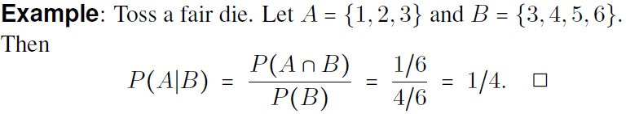
Basics
Notes:
You can interpret as The probability of A given the updated information that B has occurred. Meaning if B has no bearing on A, then it would just be P(A) over P(B)

Slide 41


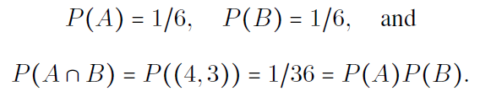


Slide 42
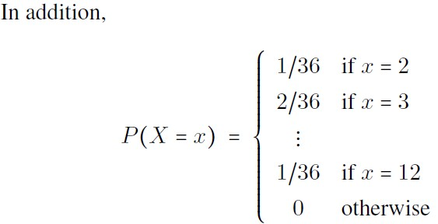
Notes:
Sample space is all possible outcomes. X is the function and x is one of the results of the function. So we can read Probability (X is equal to x result) is yada yda yda.

Slide 43
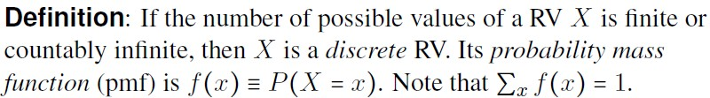
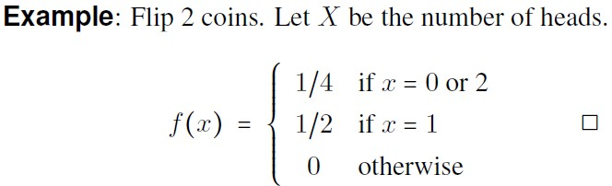

Notes:
Countably] infinite – that means there could be an infinite number of values but they have a 1-1 correspondence. Basically this means each possible value has a non-zero probability. X is the random variable from possible x’s. Read the pmf of x as the probability that the random variable X is equal to a singular outcome. The pmf is translating the output of X into the likeliness of it’s different results x.

Slide 44
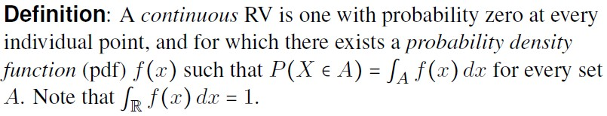
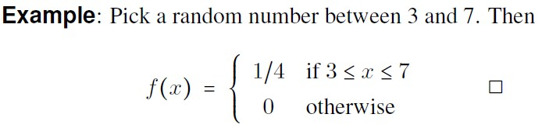

Notes:
You can get probabilities from the pdf. PDF itself is not a probability. So for example. From 3 to 7, the exact prob of picking “5” is 0, but the pdf is ¼ because if you integrate ¼ over the range of 3 to 7 you get 1. When this is continuous – A is the set, so think of 1<=x <=2 that set of numbers between 1 and 2 is the set A. So the pdf is the integral.

Slide 45
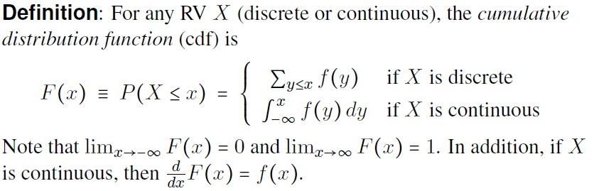

Slide 46
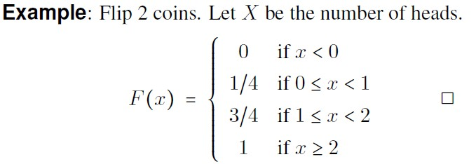

Slide 47
Summary
Started our review of Probability by touching on the basics.
Next Time: We’ll finally formally simulate some random variables! About time, eh?

Slide 48
Computer Simulation
Module 2: Calculus, Probability, and Statistics Primers
Dave Goldsman, Ph.D.
Professor
Stewart School of Industrial and Systems Engineering
Simulating Random Variables

Slide 49
Lesson Overview
Last Time: We started our Probability Primer!
This Time: We’ll show how to simulate some easy random variables on the computer.
This is one of the main reasons that you’re taking the course!

Slide 50
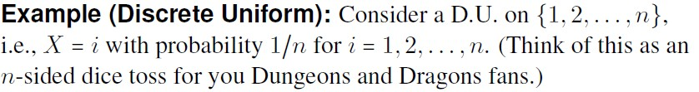

Slide 51
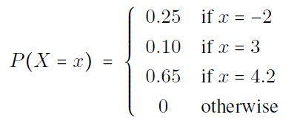
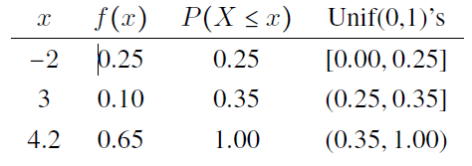

Slide 52

Notes:
In the example, we are assuming X is an random Exponential variable. And the cdf is the F(x) function. Then when you set F(X) instead of F(x) you get that new equation which becomes uniformly distributed.

Slide 53
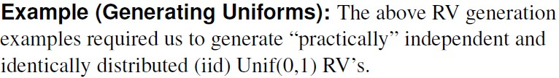
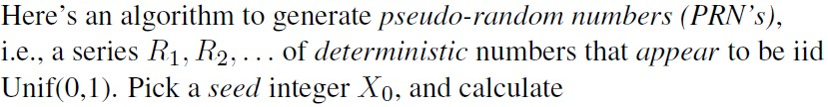


Slide 54
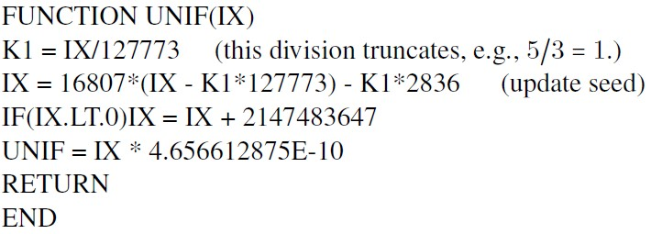

Slide 55
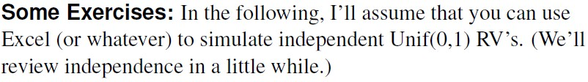
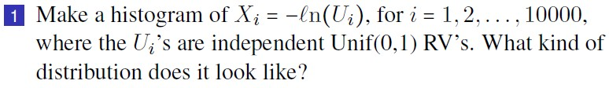
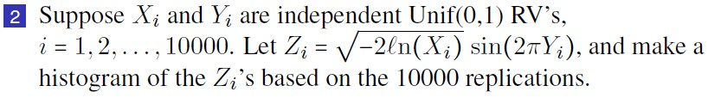
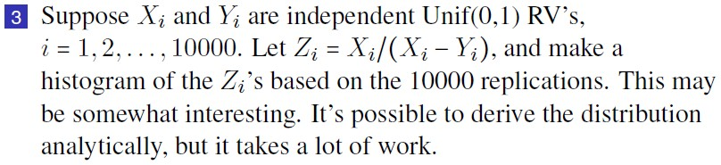

Slide 56
Summary
This was a “starter” lecture on random variate generation – something to get you psyched up for what’s coming up!
Next Time: I know you’ve been expecting a nice lecture on expectations!

Slide 57
Summary Placeholder
Talked about blah blah blah…
This completes Module 2, which went over blah blah blah
Coming up: Module 3 will blah blah blah

